Slide 1
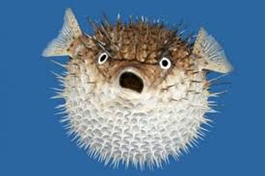
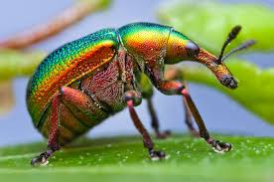
The mechanisms of ventilation and gas exchange in bony fish and insects

Slide 2
Learning Objectives
By the end of this lesson you should be able to describe and explain the main features of gas exchange systems of fish and insects
To include,
  • bony fish – changes in volume of the buccal cavity and the functions of the operculum, gill filaments and gill lamellae (gill plates); countercurrent flow
  • insects – spiracles, trachea, thoracic and abdominal movement to change body volume, exchange with tracheal fluid.

Slide 3
Features of gas exchange surfaces
Large surface area
Maintenance of high concentration gradient
Short distances for exchange/thin exchange surfaces
Good blood supply

Slide 4
Oxygen Availability in Water
Much lower oxygen concentration
Concentration varies with temperature
higher temp= lower oxygen
Water is more viscous than air so requires more energy to pass across the gas exchange system
Air moves in and out of animals on land but water moves past in 1 direction

Slide 5
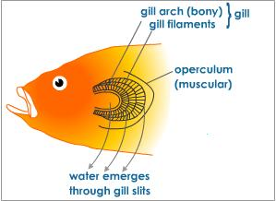

Slide 6
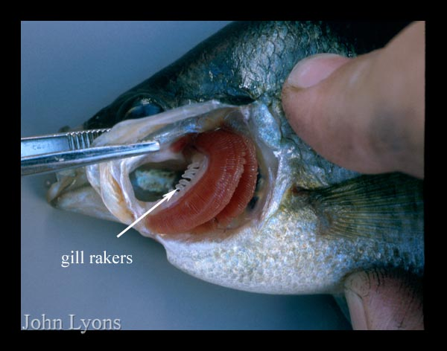
Bony Fish

Slide 7
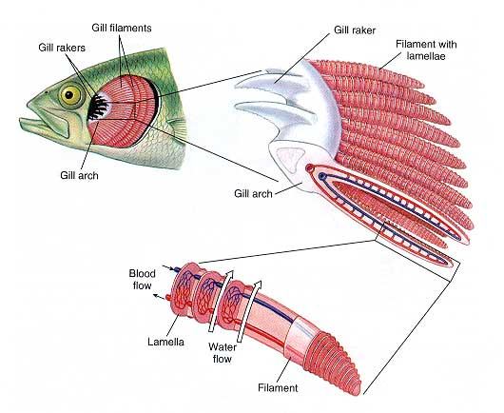
Gill Rakers
Made of bone or cartilage to prevent food particles reaching the gill filaments and obstructing gas exchange
Gill arches are attached to 2 rows of filaments
Rich blood supply within the gill arches and filaments

Slide 8
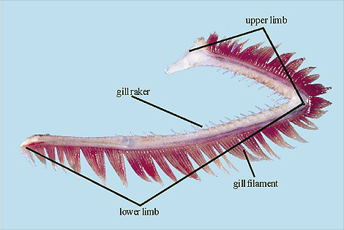
Gills have a large surface area
Composed of several gill arches on each side .
Each gill arch has many gill filaments

Slide 9
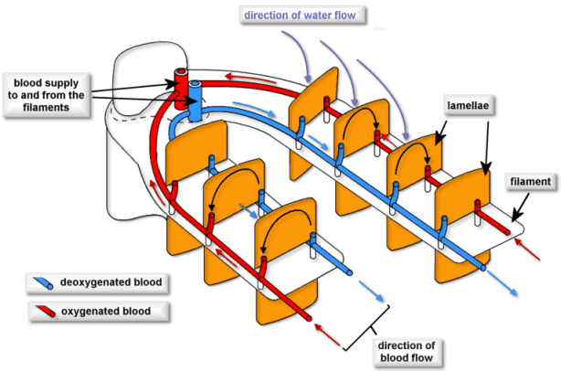
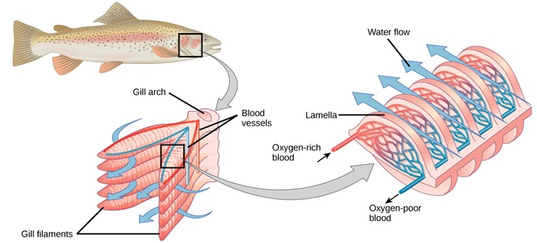
The countercurrent flow of water and blood

Slide 10
Parallel Flow
Countercurrent Flow
3O₂
Red Blood Cell
3O₂
O₂
3O₂
O₂
3O₂
2O₂
3O₂
2O₂
2O₂
3O₂
3O₂
4O₂
4O₂
O₂
4O₂
5O₂
5O₂
5O₂
Water
Water
Capillary
Capillary

Slide 11
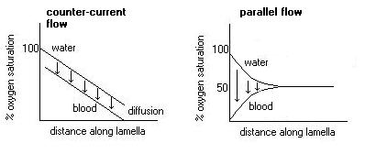
Counter current flow across the gill filaments

Slide 12
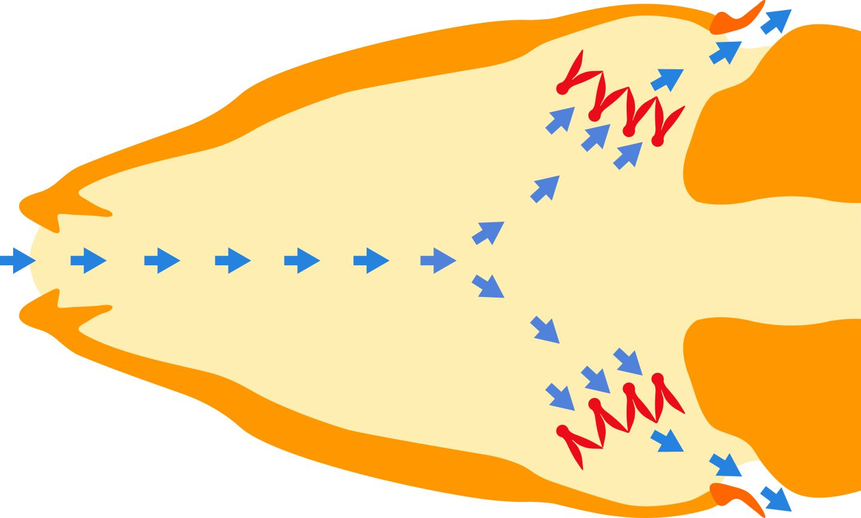
Buccal cavity
Water is drawn in and forced between the gill arches
Gill arches
Opercular valve
operculum

Slide 13
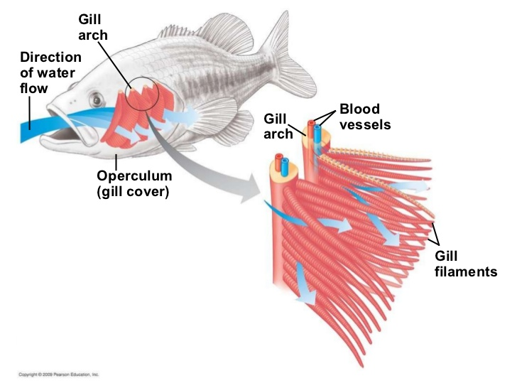
Gill filaments overlap to increase resistance to water flow and slow down the speed it passes through them.

Slide 14
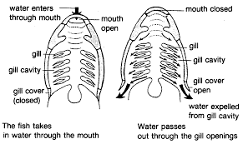
Gill Ventilation
Opening mouth and closing opercular valve
increases volume of the buccal cavity, so pressure falls drawing water in
Closing mouth and opening opercular valve
decreases volume of the buccal cavity, so pressure increases forcing water out through operculum past gills
This is a continuous process resulting in constant flow across the gills

Slide 15
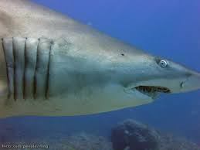
Cartilaginous Fish (sharks)
These fish don’t have an operculum and water will only flow past their gills if they keep moving

Slide 16
Features of gas exchange surfaces in fish
Large surface area/ many gill filaments
Maintenance of high concentration gradient by blood flowing through the filaments and the countercurrent flow system between blood and water movement
Short distances for exchange/thin exchange surfaces
Good blood supply within the gill filaments
Overlapping gill filaments slow water movement to ensure sufficient time for diffusion

Slide 17
Insect Gas Exchange
No blood pigments to pick up and deliver oxygen or remove carbon dioxide
Exoskeleton so gases can’t diffuse across the body surface
High activity such as flying so need lots of oxygen

Slide 18
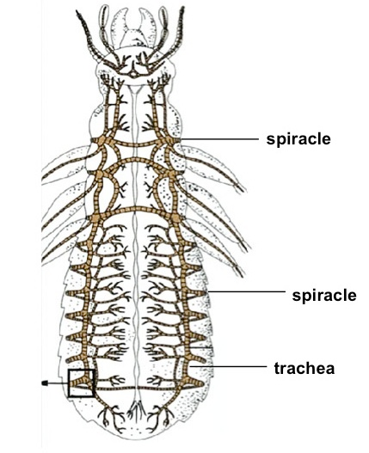
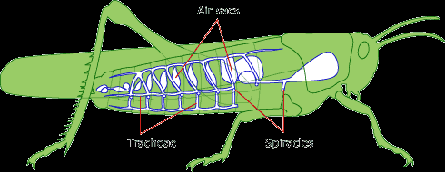
Insect Tracheae
A system of tracheae branch throughout the insect. The tracheoles terminate in the tissues. Spiracles are positioned along the thorax and abdomen

Slide 19
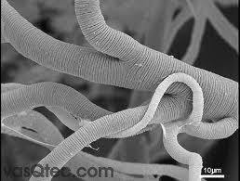
Spirals of chitin give the tracheae strength. The chitin will prevent gas exchange.
Gases move by diffusion along the tracheae

Slide 20
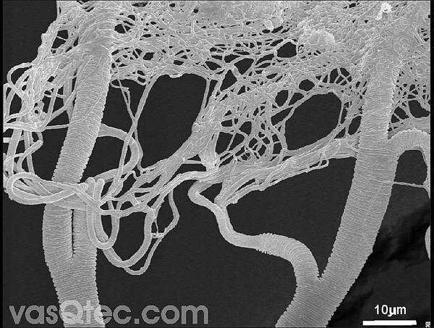
Tracheoles’ diameter is about 0.8μm.
They spread between individual cells
Very large numbers so this gives a very large surface area
They have no chitin so gases can cross them
Tubes are moist so gases dissolve in them helping diffusion
They may contain tracheal fluid. This reduces diffusion but during intense activity tissues accumulate lactic acid which lowers the water potential. The fluid is drawn out of the tracheoles by osmosis which allows more space for diffusion to occur

Slide 21
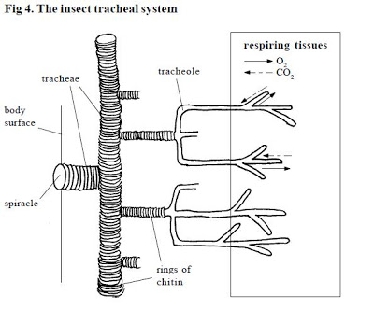
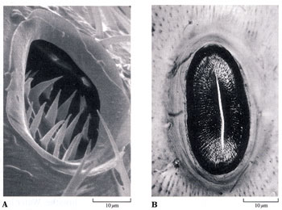
Fluid filled tracheoles
Sensory hairs in the spiracles monitor external conditions
Spiracles can close to reduce water loss when insect is inactive

Slide 22
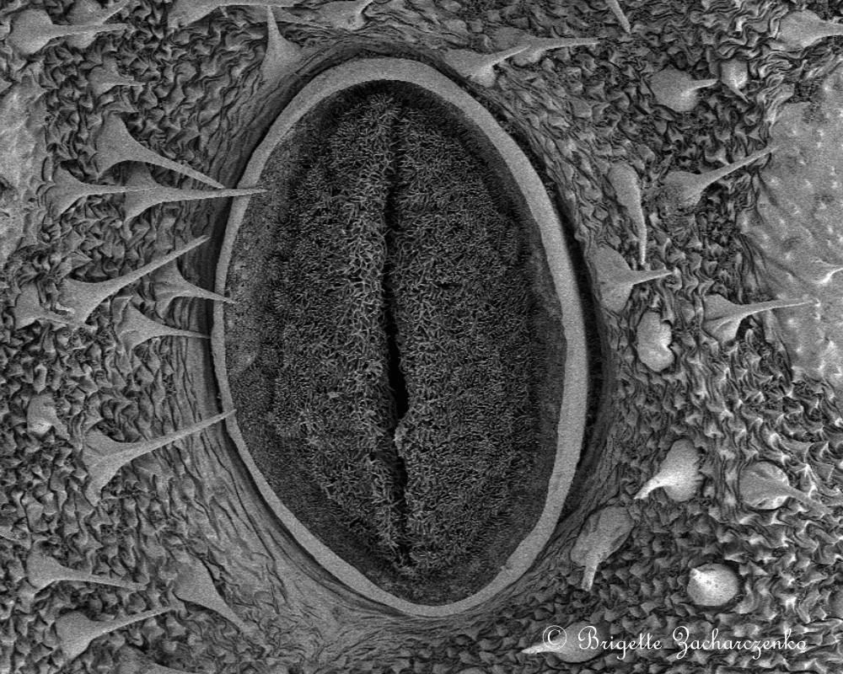
Caterpillar spiracle

Slide 23
Adjusting Gas Exchange
Opening and closing the spiracles
Ventilating the tracheae by muscular contractions of the abdomen which create pressure changes and draw air in.
Internal air sacs which act as resevoirs
Fluttering the spiracles to waft oxygen in whilst reducing water loss.
Holding onto CO₂ until it builds up to a high level in the body fluids and then opening the spiracles and releasing it all at once

Slide 24
Comparing Gas Exchange Systems
 | Fish | Insects | Humans
Large surface area
Maintaining concentration gradients
Short distances for gas exchange
Good blood supply

Slide 25
Comparing Gas Exchange Systems
 | Fish | Insects | Humans
Large surface area | Many gill filaments on gill arches
Maintaining concentration gradients | Countercurrent flow of water and blood Movement of blood through the gill filaments Drawing water through gill arches
Short distances for gas exchange | Water circulates past the gill arches.
Good blood supply | Rich blood supply within gill filaments

Slide 26
Comparing Gas Exchange Systems
 | Fish | Insects | Humans
Large surface area | Many gill filaments on gill arches | Vast tracheole network
Maintaining concentration gradients | Countercurrent flow of water and blood Movement of blood through the gill filaments Drawing water through gill arches | Ventilation of the abdomen by pumping air in Building up lactic acid in tissues draws air in
Short distances for gas exchange | Water circulates past the gill arches. | Tracheoles penetrate between cells and tissues
Good blood supply | Rich blood supply within gill filaments | N/A

Slide 27
Comparing Gas Exchange Systems
 | Fish | Insects | Humans
Large surface area | Many gill filaments on gill arches | Vast tracheole network | Large numbers of alveoli
Maintaining concentration gradients | Countercurrent flow of water and blood Movement of blood through the gill filaments Drawing water through gill arches | Ventilation of the abdomen by pumping air in Building up lactic acid in tissues draws air in | Blood flows past the alveoli removing blood with high O₂ Breathing in and out brings more O₂ in and removes CO₂
Short distances for gas exchange | Water circulates past the gill arches. | Tracheoles penetrate between cells and tissues | Alveoli and capillaries are made up of squamous epithelial cells which are flat. RBC pushed up against capillary walls
Good blood supply | Rich blood supply within gill filaments | N/A | Extensive capillary network

Slide 28
Learning Objectives
The mechanisms of ventilation and gas exchange in bony fish and insects
To include,
  • bony fish – changes in volume of the buccal cavity and the functions of the operculum, gill filaments and gill lamellae (gill plates); countercurrent flow
  • insects – spiracles, trachea, thoracic and abdominal movement to change body volume, exchange with tracheal fluid.

