Slide 1
Antibodies
Thursday, 24 March 2016
Learners should be able to demonstrate and apply their knowledge and understanding of:
the structure and general functions of antibodies
  To include the general structure of an antibody molecule.
an outline of the action of opsonins, agglutinins and anti-toxins

Slide 2
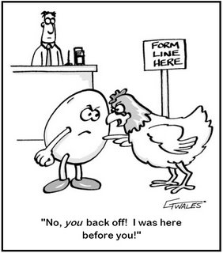
Starter: What came first?
The T cell
The B cell
The T killer cell

Slide 3
Task 1
Label the different regions of an antibody using the labels provided.
Support: Text books
Extra challenges:
Explain the importance of the variable regions.
What is an antigen-antibody complex?
LO: Describe the structure of antibodies.
Notes:
Worksheet on the last slide.

Slide 4
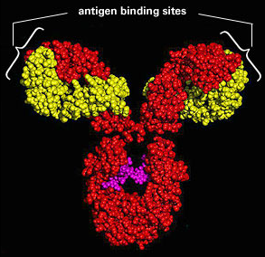

Slide 5
Antibody Structure
Each antibody has a different shaped variable region of 110 amino acids
2 variable regions allow the antibody to bind to 2 of the same antigens
The specificity of the antibody depends on its variable regions
Antigen
Variable regions (red)
Light chain
The constant regions are the same for all antibodies and this is how phagocytes can recognise them
Hinge region
Allows flexibility
Disulphide bridges hold the heavy and light chains together
Heavy chain
Constant regions
(blue)
Each antibody is complementary to one specific antigen which it can bind to forming an antigen-antibody complex

Slide 6
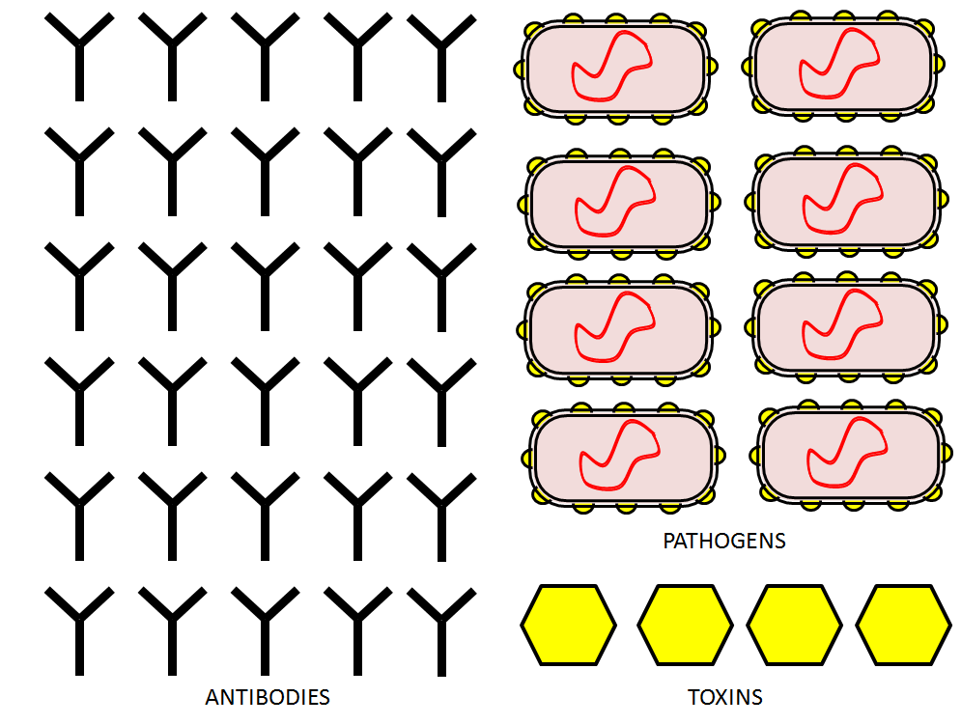
Task: How do antibodies work?
Using the templates sheet, make a poster explaining how antibodies can fight infection.
You should include:
Neutralisation
Agglutination
Opsonisation
Support: Text books, peers
Extra challenge: How do antibodies prevent viruses entering a cell?
LO: Compare the different modes of action of antibodies.

Slide 7
Agglutination
Antibodies act as agglutinins which can cause microbes to stick together
This makes it easier for phagocytes to engulf them

Slide 8
Neutralisation
Some pathogens make us ill by producing toxins
Some antibodies work by producing anti-toxins which can neutralise them by blocking their action

Slide 9

Opsonisation
The binding of an antibody such as IGG or IgM to the surface of a pathogen can tag the pathogen which helps the phagocyte identify it and then engulf it
Some opsonins can make the pathogen walls leaky so that they swell up and burst

Slide 10
Viruses have proteins on their surface which recognise and bind to receptors on the surface of the host cell
This is how many viruses enter their host cell
Antibodies can bind to viruses forming an antigen antibody complex which stops them attaching to their host cells

Slide 11
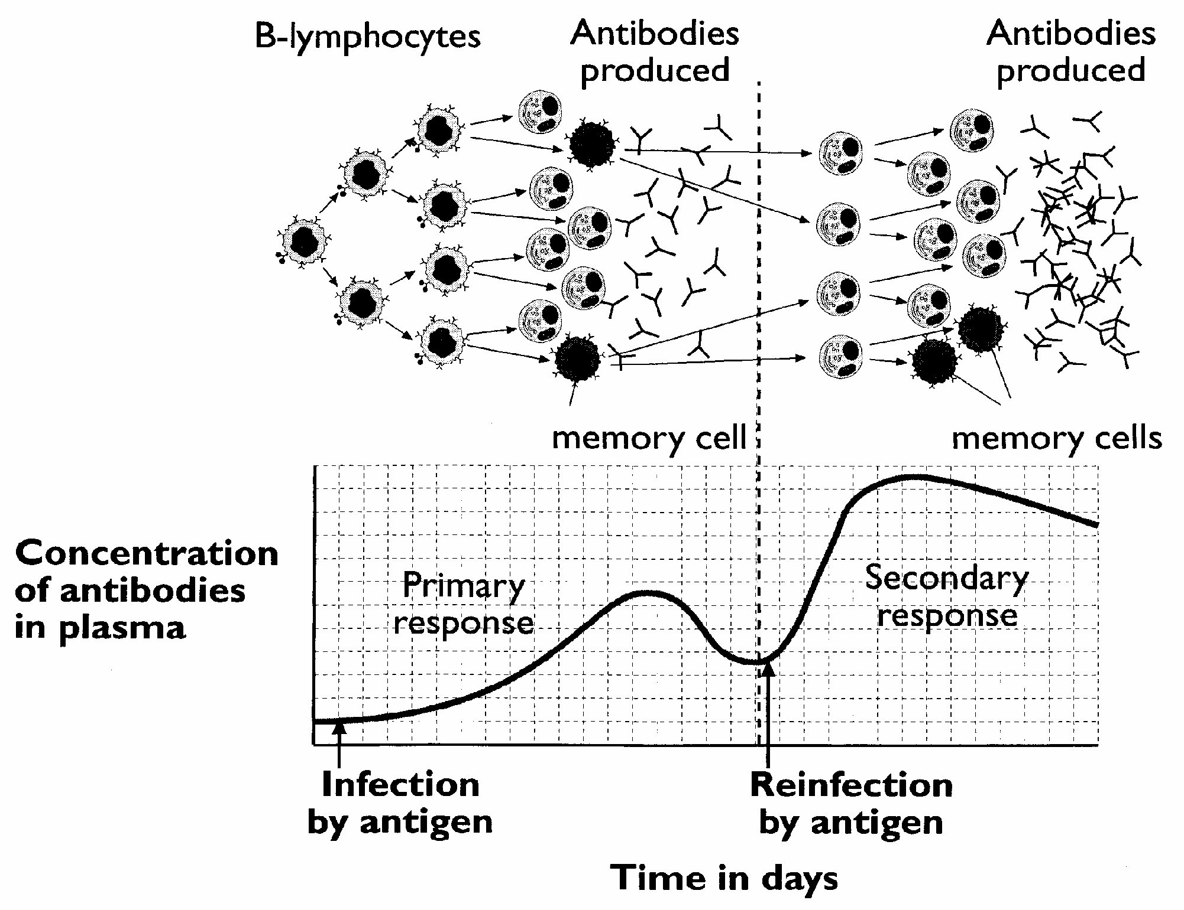
Primary – establishes immunological
memory

Slide 12
Primary and secondary responses
Annotate your graph of the primary and secondary responses by adding the following labels:
  Clonal selection
  Clonal expansion (more plasma cells and Killer T etc)
  Mitosis
  Development of memory cells
Questions:
Compare the primary and secondary responses in terms of time taken, decline of antibodies and antibodies produced.
Memory cells are produced in the primary response, how else could these be produced without the person being infected?
Extra challenge: What causes the secondary response to occur more rapidly?

Slide 13
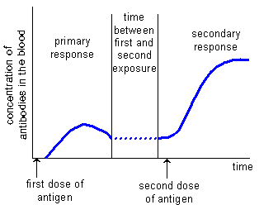
Antibody Concentration – Primary and Secondary Response
Primary Response
Infection (Ag)
Lag phase
3 Antibodies produced
4 Antibody level rises
to combat infection
5 Ag dealt with
6 Ab level declines – short lived
Secondary Response
After the primary response, Ab’s do not stay in blood – the level declines
If the body is infected by the same Ag a second time Ab’s must be made again
Re-infection causes much more rapid and a stronger immune response – concentration of Ab’s rises sooner- reaches a higher concentration – more plasma cells than in 1o response – more cells to respond to Ag; less time to produce same number of plasma cells –hence, a greater [Ab] compared to 1o response; increased affinity of Ab for Ag.
This is due to the presence of memory cells (made during the primary response) – no need for antigen presentation and clonal selection
Long-lived; basis of vaccination

Slide 14
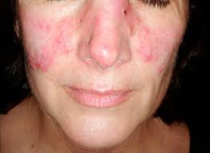
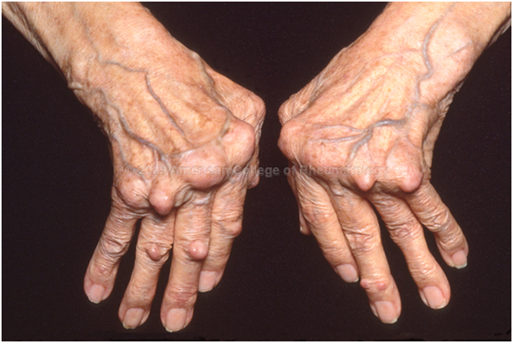
Autoimmune diseases
The immune system stops recognising some cells as ‘self’ to will attack them causing inflammation and destruction of healthy tissues
Three of the most common
  Type 1 diabetes damages the β cells in the pancreas
  Rheumatoid arthritis attacks joints causing scarring and swelling
  Lupus which can damage many organs such as kidneys and liver and skin often causing a persistent facial rash
There are no cures for these diseases but can be managed with other medications such as insulin injections or immunosuppresants

Slide 15
Plenary: True or False?
Antibodies have a variable region specific to a pathogens antigens.
Antibodies contain a sulphide bridge.
A antigen-antibody complex is formed when an antibody binds to a pathogen’s antigens.
Agglutination makes it easier for phagocytes to engulf pathogens.
Neutralisation only occurs with viruses.
Opsonisation causes phagocytes to swell and burst.
Antibodies can stop viruses entering host cells.
The primary immune response produces memory cells.
The secondary immune response is caused by vaccination.
The secondary immune response is quicker.

Slide 16
Resources

Slide 17
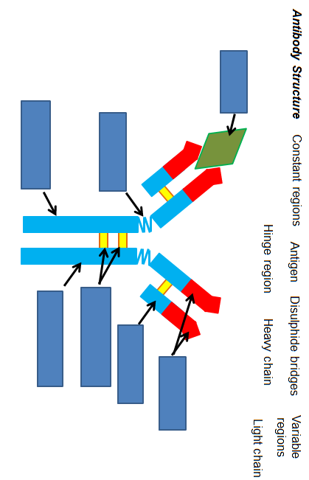

Slide 18
PATHOGENS
ANTIBODIES
TOXINS

