Slide 1
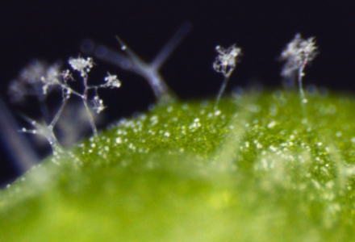
Plant Defences Against Pathogens
Notes:
NB all photos and diagrams in this presentation are sourced from websites that come under the creative commons attribution or references have been acknowledged.

Slide 2
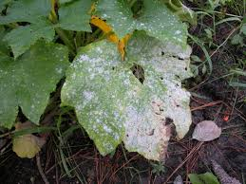
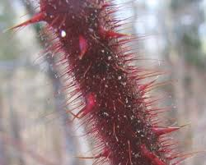
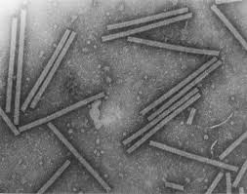
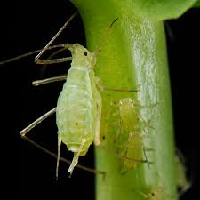
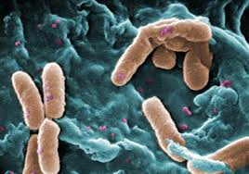
What’s the attraction?
Plants are a rich source of nutrients for many organisms including bacteria, fungi, protoctista, insects, and vertebrates…
Notes:
1) Fungal infection 2) Spikey stem 3) plant virus 4) aphids 5) plant bacterial infection

Slide 3
Do plants have an immune system?
Plants do not have an immune system comparable to animals…
… but they have developed an array of structural, chemical and protein-based defences designed to detect invading organisms and stop them before they are able to cause extensive damage.

Slide 4
Recognising an attack
Plants are not passive – they are able to respond rapidly to pathogen attacks.
Receptors in the cells respond to molecules from the pathogens, or to chemicals produced when the plant cell wall is attacked.
This stimulates the release of signalling molecules that appear to switch on genes in the nucleus.
This in turn triggers cellular responses, which include:
  Producing defensive chemicals
  Sending alarm signals to unaffected cells to trigger their defences
  Physically strengthening the cell walls

Slide 5
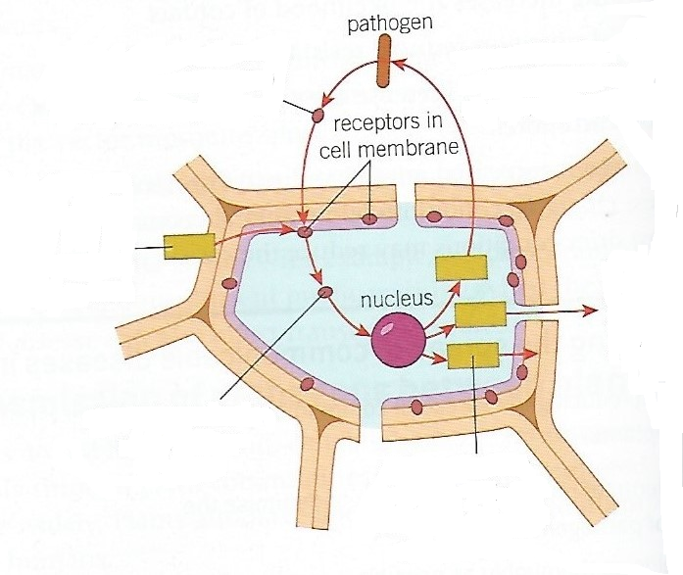
Some molecules from the pathogen are recognised directly by the plant cell
Some defensive molecules directly attack the pathogen
When pathogenic enzymes break down the cell wall the breakdown products are recognised
Defensive chemicals give the alarm to other cells before they are attacked
Signalling molecules alert nucleus to an attack
Polysaccharides (Callose and lignin) made to strengthen the cell walls

Slide 6
Plant Defences
Protection from a pathogen’s initial invasion is achieved via passive defences, such as physical and/ or chemical barriers.
Physical barriers
Wax
Cuticle
Cell wall
Stomata
Callose deposition
Plant Defences
Nutrient deprivation
pH
Phytoanticipins
Plant defensins
Chemical barriers

Slide 7
Physical barriers involve the plants surface, i.e. the cuticle, stomata and cell walls.
Some pathogens are able to produce a range of cutin-degrading enzymes, which are often crucial to the pathogen being successful and penetrating the plant tissue.

Slide 8
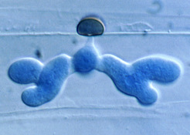
Microscope image showing a fungal hypha that penetrated an epidermal cell of Arabidopsis
© Dr. Richard O'Connell, MPI for Plant Breeding Research

Slide 9
The thickness of the cuticle, the presence of a secondary cell wall, and the size of the stomatal pores can all affect the success with which a pathogen invades a host.
Some plants have very thick cell walls and/or cuticles, and bark which can all provide a better barrier to infection.
Some plants also have leaves which have a vertical orientation. This prevents the formation of moisture films on the leaf surface, inhibiting infection by pathogens that are reliant on water for motility.

Slide 10
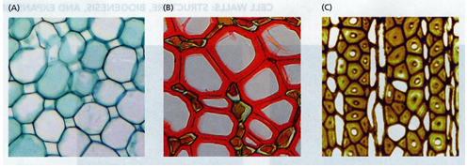
Diversity of plant cell wall structure. (A) primary, and (B)-(C) secondary cell walls (source: Taiz L., Zeiger E., 2010)

Slide 11
Callose
When plants are attacked by pathogens, they produce high levels of a polysaccharide called Callose, which contain β-1,3 linkages and β-1,6 linkages between glucose monomers. Scientists still do not fully understand the role played by Callose but current research suggests:
Callose is synthesised and deposited between cell walls and cell membranes in the cells next to the infected cells - acting as barriers, preventing the pathogens entering the plant cells around the site of infection.
Large amounts of Callose continue to be deposited in cell walls after initial infection. Lignin is added, making the mechanical barrier even thicker and stronger.
Callose blocks sieve plates in the phloem, sealing off the infected part and preventing the infection from spreading.
Callose is deposited in the plasmodesmata between infected cells and the neighbouring cells, sealing them off from healthy cells.

Slide 12
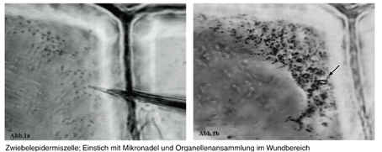
This image shows callose being deposited as part of a response to being punctured with a needle at the plant cell wall. (Lang et al., 2003). *Image permission pending*

Slide 13
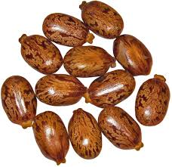
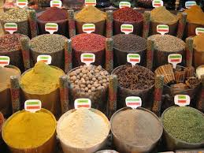
Chemical defences
Many plants are able to produce powerful chemicals that can either repel the insect vectors of disease or kill invading pathogens.
Castor oil beans produce ricin, which is used as a defensive chemical. Just 0.2mg would be fatal if ingested…..
Some chemicals are so powerful we extract them and use them to control insects, fungi and bacteria…
Some have strong flavours and are used as herbs and spices….

Slide 14
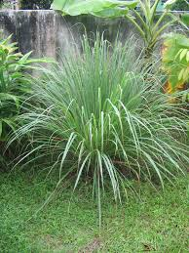
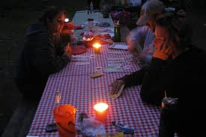
Examples of plant defensive chemicals….
Insect repellents – e.g. citronella from lemon grass.
Citronella is extracted and used in outdoor candles to burn and produce an odour that repels insects…

Slide 15
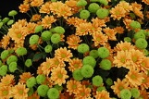
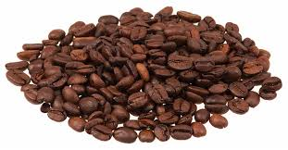
Insecticides
e.g. pyrethrins made by chrysanthemums and act as insect neurotoxins;
e.g. caffeine which is toxic to insects and fungi

Slide 16
Antibacterial compounds – including antibiotics!
phenols which are an antiseptic made in many different plants.
antibacterial glossypol produced by cotton.
Defensins which are plant proteins that disrupt bacterial and fungal cell membranes.
Lysosomes – organelles containing enzymes that break down bacterial cell walls.

Slide 17
Antifungal compounds
Phenols
Glossypols
Caffeine – toxic to fungi and insects!
Saponins – chemicals in many plant cell membranes that interfere with fungal cell membranes.
Chitinases – enzymes that break down the chitin in fungal cell walls.

Slide 18
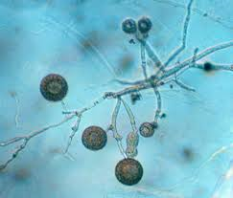
Oomycota or oomycetes form a distinct phylogenetic lineage of fungus-like eukaryotic microorganisms. They are filamentous, microscopic, absorptive organisms that reproduce both sexually and asexually.
Anti-oomycetes
Glucanases are enzymes made by some plants that break down glucans; polymers found in the cell walls of oomycetes (e.g. P. infestans)

Slide 19
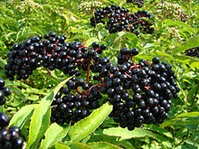
General toxins – some plants produce chemicals that can be metabolised (broken down) to form cyanide compounds. Cyanide is toxic to most living things!
The ripe, cooked berries (pulp and skin) of most species of Sambucus (elderberry) are edible. However, most uncooked berries and other parts of plants from this genus are poisonous. The leaves, twigs, branches, seeds, and roots of Sambucus plants can contain a cyanide-inducing glycoside (a glycoside which gives rise to cyanide as the metabolism processes it). Ingesting a sufficient quantity of cyanide-inducing glycosides can cause a toxic build-up of cyanide in the body.

Slide 20
Inhibiting compounds may be excreted into the external environment, accumulate in dead cells or be secreted into vacuoles in an inactive form.
The young fruit of numerous plants (e.g. mangoes and avocado) contain antifungal or antimicrobial compounds that are gradually metabolised (broken down) during fruit ripening. This makes unripe fruit less susceptible to disease than ripe fruit.

Slide 21
Make a table or diagram to summarise plant defences against pathogens.
(4 marks)
To include:
Production of defensive chemicals (1)
An example e.g. insect repellents, insecticides, antibacterial compounds including antibiotics, antifungal compounds, anti-oomycetes, general toxins (1)
Physical defences (1)
An example e.g. callose barriers immediately, callose and lignin deposition in cell walls longer term, callose blocking sieve plates to prevent spreading through phloem, callose deposited in plasmodesmata to prevent spread from cell to cell (1)
Sending alarm signals to uninfected cells so they can put defences in place (1)

