Slide 1
The Immune System
Professional Tutoring
Alevelsolutions.com

Slide 2
The immune system
Changing your lifestyle can help reduce your chances of getting disease but….
Infectious disease is another matter!
Antigens are molecules, usually proteins or polysaccharides.
When a pathogen enters a body its antigens are recognised as foreign and they body realizes it has to do something about it.

Slide 3
Phagocytes
Phagocyte (e.g. a macrophage) is a type of white blood cell. It carries out a process called phagocytosis. That is it engulfs and digests a pathogen.
There are several steps to this process as shown on the next slide.

Slide 4
Phagocytosis
A phagocyte recognises the antigens on a pathogen
The cytoplasm of the phagocyte moves round the pathogen, engulfing it.
A phagocytic vacuole is formed which has the pathogen engulfed in it.
Lysosome fuses itself with the phagocytic vacuole which contains lysosomal enzymes that breaks down the pathogen
To activate the other immune system cells the phagocyte presents the antigens to them.

Slide 5
T-cells and B-Cells
A T-sell is another type of white blood cell that carries out its job in 2 ways
It releases substances to activate B-cells
Attach to antigens on a pathogen and kill the cell.
Remember the antigens are presented to it by phagocytes. T-cells have proteins that bind to the antigens and kill them!

Slide 6
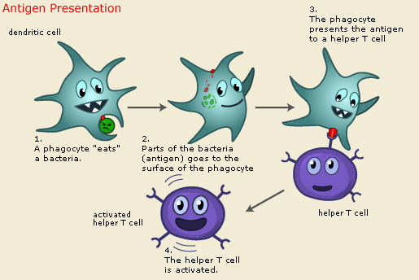
T-cell

Slide 7
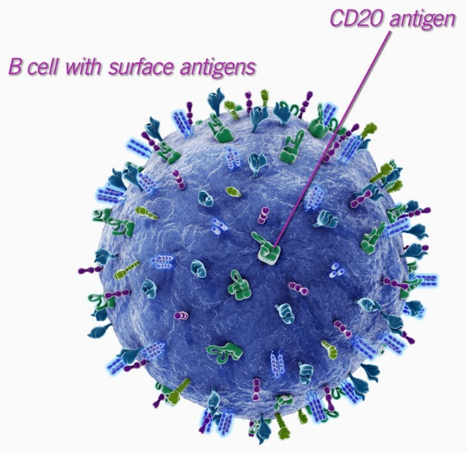
T-cells activate B-cells
B-cell is another type of white blood cell. They are covered with antibodies that bind with antigens making am antigen-antibody complex.
The antibodies on a B-cell are on its membrane. Differently shaped antibodies bind to differently shaped antigens.

Slide 8
B-cells divide into Plasma cells!
We’re almost there!
The antigens on a B-cell bind to the complimentary shaped antigen
This, together with the substances released from the T-cells, activates the B-cells.
The activated B-cell divides into plasma cells.

Slide 9
Plasma cells
Plasma cells are identical to B-cells.
They secrete lots of the antibody specific to the antigen.
Antibody functions include:
Coating the pathogen to make it easier for the phagocyte to engulf it
Coating the pathogen to prevent it from entering host cells
Binding to and neutralising toxins produced by the pathogen.

Slide 10
2 Types of immune response
Cellular – T-cells and other immune system cells that they interact with.
Humoral – B-cells and the production of antibodies make the humoral response.

Slide 11
Check your learning
What is a pathogen?
What is a phagocyte?
Give a name of a phagocyte?
List the 5 steps of how a phagocyte works.
Phagocytes activate?
What activates B-cells?
B-cells divide into?
The immune response can be split into 2. Name the 2.
Antigens are made of?

Slide 12
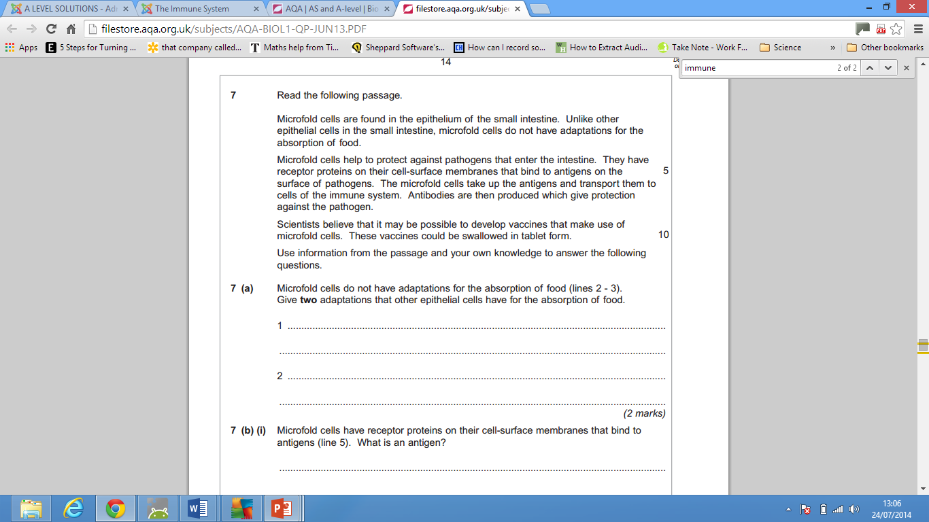
Exam question

Slide 13
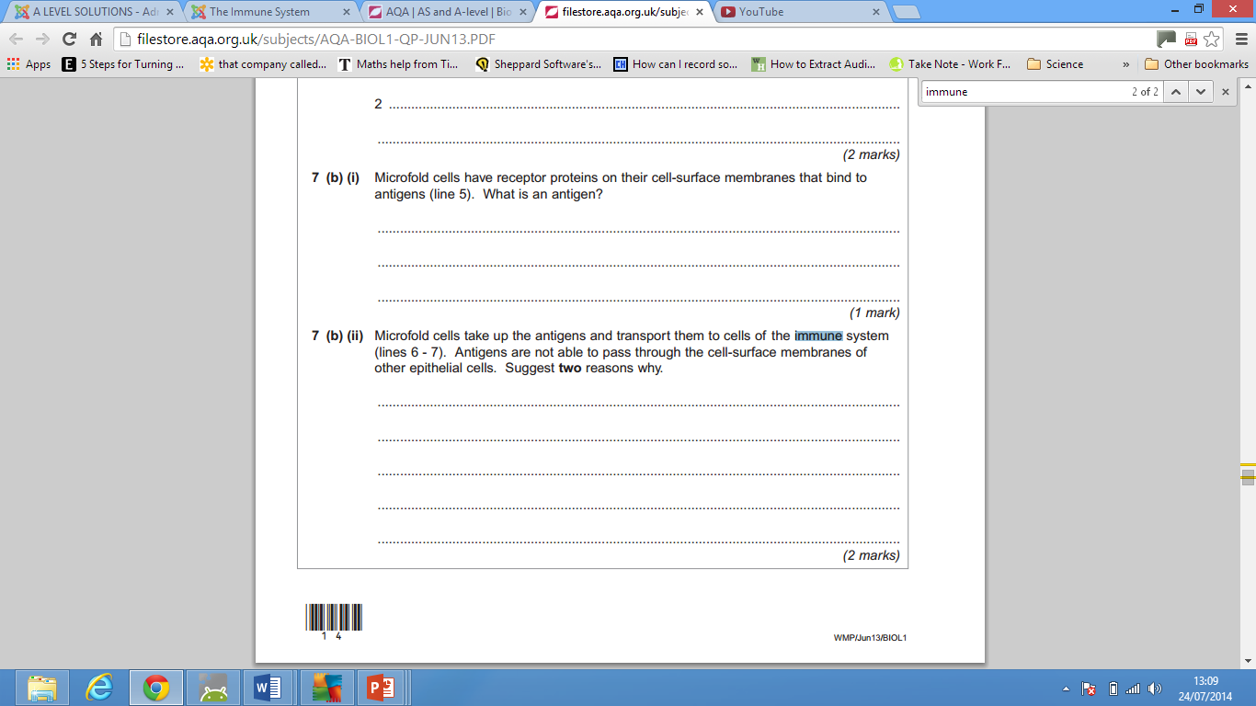
Exam question continued

Slide 14
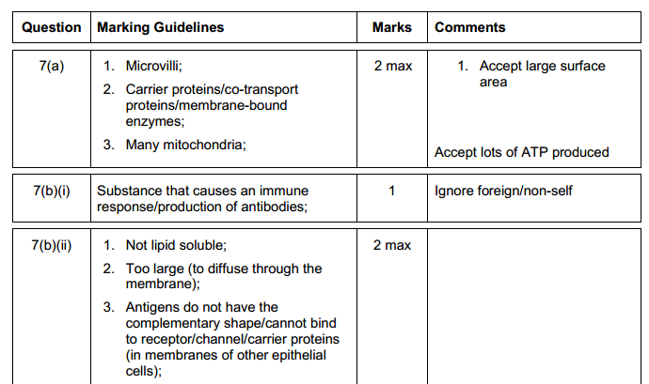
Answers

