Slide 1
Statistics

Slide 2
Student’s t Test
Compares the means and spread of the data.
This can be paired and unpaired data
Unpaired
Data is from 2 different groups
E.g. germination rate of seeds at 2 different temperatures
Paired
2 sets of data from the same individuals
E.g. pulse rate at rest and exercise

Slide 3
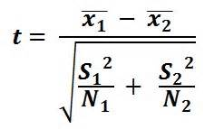
Unpaired Student’s t
Null Hypothesis
There is no significant difference between the mean germination rates at the 2 different temperatures
This test uses this formula
The degrees of freedom is worked out as
n₁ + n₂ -2
Calculate the value of t
Compare to the critical value at the 5% probability
If t is greater than the critical value there is a significant difference between the means (reject the Null Hypothesis)

Slide 4
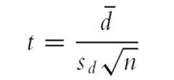

Paired Student’s t
Null Hypothesis
There is no significant difference between the mean pulse rates at rest and exercise
This test uses this formula
The degrees of freedom is worked out as
n-1
Mean of differences between each pair of measurements
-
Alternative arrangement
$$\frac{d \sqrt{n}}{S }$$
d
Standard deviation of the differences between each pair of measurements
Calculate the value of t
Compare to the critical value at the 5% probability
If t is greater than the critical value there is a significant difference between the means (reject the Null Hypothesis)
n = number of pairs

Slide 5
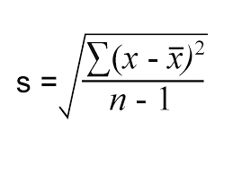
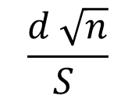

Heart Rate
Heart Rate (BPM) |  | d
Rest | After running 200m
75 | 120 | 45
62 | 126 | 64
70 | 114 | 44
71 | 119 | 48
73 | 132 | 59
68 | 118 | 50
72 | 135 | 63
70 | 117 | 47
d = 52.5
Sd (standard deviation of the difference) = 8.2bpm
$$\frac{d \sqrt{n}}{S }$$
d
(52.5x $√$8) $÷$8.2 = 18.11(2d.p)
Df = 8-1 =7
Refer to the table of critical values as before although often at the 1% probability

Slide 6
Spearman’s Rank Correlation Coefficient
Two measurements can be plotted on a graph to produce a scattergram.
This can show if these two variables are linked in some way.
  E.g as one variable increases the other variable increases = positive correlation
  As one variable increases the other variable decreases= negative correlation.

Slide 7
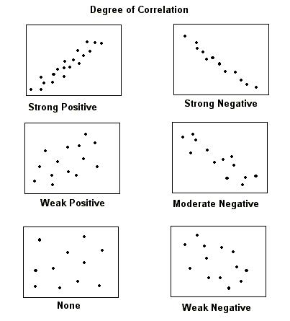
The calculation of the correlation coefficient will establish if the correlations are significant.

Slide 8
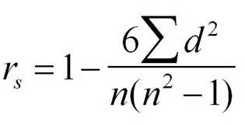
Spearman’s Rank Correlation Coefficient
d is the difference between the 2 rankings
Spearman’s Rank coefficient
n= the number of sets of measurements

Slide 9
What does the vale of r mean?
It will be from 1 to -1
A coefficient of 0 means there is no correlation
A value of 1 means there is a perfect positive correlation
A value of -1 is a perfect negative correlation
The value of r should be compared to a table of critical values to establish if the correlation is significant or not. The sign + or – is not important for this stage.

Slide 10
Investigating the correlation between age and reaction times
SAMPLE | Age (years) | Reaction time (s)
1 | 15 | 2.1
2 | 45 | 3.2
3 | 34 | 2.9
4 | 26 | 2.9
5 | 73 | 3.7
6 | 36 | 2.2
7 | 78 | 3.6
8 | 92 | 3.9
9 | 44 | 2.8
10 | 64 | 3.5

Slide 11
Investigating the correlation between age and reaction times
Rank the two variables from smallest to largest.
  If two readings are the same give them a middle rank, i.e. if two ranks are both 6th give them both 6.5 and the next rank will be 8.
Work out the difference between the ranks of the variables for each person and then square .
Add up the values of d² to obtain a total Ʃd²

Slide 12
Investigating the correlation between age and reaction times
Insert the values into the formula

Slide 13
Spearman’s Rank Tables of Critical values
n | Probability Levels
 | 10% | 5% | 2% | 1%
8 | 0.643 | 0.738 | 0.833 | 0.881
9 | 0.600 | 0.683 | 0.783 | 0.833
10 | 0.546 | 0.648 | 0.745 | 0.794
11 | 0.523 | 0.623 | 0.736 | 0.755

