Slide 1
t-test - paired
Testing for a difference
Notes:
Note: this is for paired data. If the data isn’t paired, use unpaired t-test

Slide 2
What does it do?
Tests for a difference in means
Compares two cases
(eg soil moisture content north & south of a hedge)
Data must occur in natural pairs
  Measurements at matched points on either side of a hedge
  Measurements at corresponding points on two shores
  Two measurements on the same person
Notes:
The pairing must be “natural” – you cannot just pair data up arbitrarily.

Slide 3
Planning to use it?
Make sure that…
Your data occur in natural pairs
You have five or more pairs of values
Your data are normally distributed
  Only continuous data (lengths, weights etc) can be normally distributed
  You can do a check by seeing if your data look roughly like this:
If your data are not normal, but are paired, use Wilcoxon
If your data are normal, but are not paired, use unpaired t-test
Notes:
If in doubt whether it’s normal, it’s better to use Wilcoxon

Slide 4
How does it work?
You assume (null hypothesis) there is no difference between the two means
The test works with the differences of the pairs of values.
If, for example, the values in the first sample were all much bigger, then all the differences would be positive
The mean and standard deviation of the differences is calculated, and put into a formula.

Slide 5
Doing the test
These are the stages in doing the test:
Write down your hypotheses
Finding the differences
Finding the mean & standard deviation
Use the formula to calculate the t-value
Write down the degrees of freedom
Look at the tables
Make a decision
Click here for an example
Notes:
The underlined terms are hyperlinks to the appropriate slide

Slide 6
Hypotheses
H_{0:} mean1 = mean2
For H₁, you have a choice, depending on what alternative you were looking for.
H_{1:} mean1 > mean2
eg: Soil moisture content is higher on the north of the hedge than the south of the hedge
or H_{1:} mean1 ≠ mean2
eg: Soil moisture content is different on the north and south sides of the hedge.
Unless you have a good biological reason for expecting one to be larger, you should choose “different” for H₁
Notes:
The form of the alternative hypothesis should be chosen before getting the data – to ensure there really is a good reason for 1-tailed version, if chosen.

Slide 7
Differences
Work out the differences between the pairs of values, including signs
Always do
sample 1 – sample 2
not the other way round,
where sample 1 is the one you expect to have larger values
Notes:
This should minimise the number of negative signs – which should reduce errors.

Slide 8
Mean & Standard Deviation
To find the mean of your differences, add them all up and divide by how many there are
To find the standard deviation s, use the formula
n = number of values
Σx² = total of the squares of the differences
These calculations can be done on a spreadsheet or graphic calculator
Notes:
See spreadsheet presentation for more details

Slide 9
Formula
Substitute your values into the formula
= mean of the differences
s = standard deviation of the differences
n = number of values
Notes:
There are other variants of this formula, but they come to the same thing

Slide 10
Degrees of freedom
The formula here for degrees of freedom is
degrees of freedom = n – 1
Where n is the number of values
You do not need to worry about what this means –just make sure you know the formula!
But in case you’re interested – the fewer values you have, the more likely you are to get a large t-value by chance – so the higher your value has to be to be significant.

Slide 11
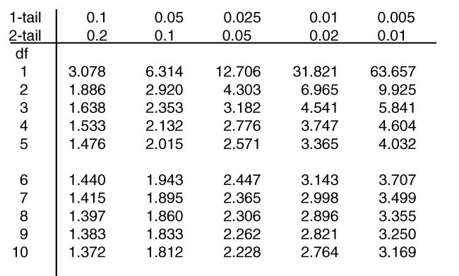
Tables
Significance levels - note
different values for 1 and 2-tailed
This is a t table
Degrees of freedom
Notes:
Some tables just quote 1-tail significance levels (or just 2 tail). Double 1-tail levels to get 2-tail levels

Slide 12
Make a decision
If your value is bigger than the tables value then you can reject the null hypothesis. Otherwise you must accept it.
Make sure you choose the right tables value – it depends whether your test is 1 or 2 tailed:
  If you are using H₁: mean1 > mean 2, you are doing a 1-tailed test
  If you are using H_{1:} mean1 ≠ mean 2, you are doing a 2-tailed test
Notes:
If you are doing a 1-tailed test and the t-value ends up negative, when you expected it to be positive – then you can’t reject H0 (and should probably go back and check your data & assumptions)

Slide 13
Example: Soil Moisture North & South of Hedge
Data were obtained for soil moisture content at seven matched points north and south of a hedge.
Hypotheses:
H_{0:} Mean moisture content on north = mean moisture content on south.
H₁ Mean moisture content on north > mean moisture content on south

Slide 14
The data
Site 1 2 3 4 5 6 7
North 4.09 2.93 3.88 10.50 3.50 5.14 4.63
South 4.65 6.00 3.47 4.33 2.20 2.50 3.33

Slide 15
Differences
We are expecting the North side to have a higher moisture content.
So we do North - South
N 4.09 2.93 3.88 10.50 3.50 5.14 4.63
S 4.65 6.00 3.47 4.33 2.20 2.50 3.33
N – S -0.56 -3.07 0.41 6.17 1.30 2.64 1.30

Slide 16
Mean & Standard Deviation
Our data (the differences) are:
-0.56 -3.07 0.41 6.17 1.30 2.64 1.30
Σx² = (-0.56)² + (-3.07)² + … + 2.64² + 1.30² = 58.3251

Slide 17
The test
Degrees of freedom = 7 – 1 = 6
We are doing a 1-tailed test
Tables value (5%) = 1.943
Since our value is smaller than the tables value, we accept H₀ – the moisture content on the north is not significantly higher.

